Slide 1
How to write good technical requirements for a product development
(or: How to define what is expected before starting to design something.)

Slide 2
Disclaimer
This training is intended as a basic introduction to technical requirements for those struggling to understand what is expected.
It is intended to help you write and monitor your requirements for technology development and product development activities (and proposals).
It does not cover Mission level requirements nor requirement engineering nor requirement engineering tools.

Slide 3
Contents
Requirements
  Why we need requirements
  Definition of requirements
  Types of requirements
  Requirement detail level vs TRL
  Requirements / recommendations for formulating technical requirements
Managing and controlling requirements
Some “golden rules”…

Slide 4
Requirements

Slide 5
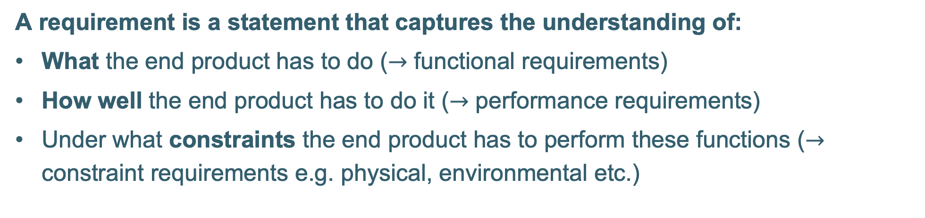
What is a requirement?
A requirement is a statement that captures the understanding of:
What the end product has to do ($→$ functional requirements)
How well the end product has to do it ($→$ performance requirements)
Under what constraints the end product has to perform these functions ($→$ constraint requirements e.g. physical, environmental etc.)

Slide 6
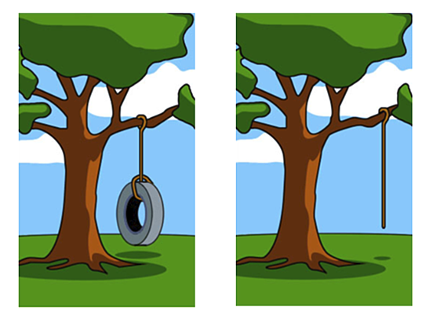
Why we need requirements
Requirements ensure that the end design/product is fit for purpose.
Requirements should form the reference for all your design work, analyses, verification and testing.
Developing with no or incomplete requirements is like driving a car
with no map and no destination!...
What was delivered due to poor requirements specification
What the customer wanted…

Slide 7
Why we need requirements
Good requirements will:
Establish a basis for agreement between the customers/stakeholders and the development team.
Reduce development effort by avoiding work going in the wrong direction.
Provide a strategy for the verification programme.
Ensure the item will perform its desired goal / objective and fit with any other systems
Provide a metric to resolve technical design trade offs
Serve as a basis for promoting the finished product.
Enable a clear identification of changes (and hence who pays).
Enable different groups to simultaneously work on different parts of a larger system.

Slide 8
Mission and Product Requirements
Mission Requirements:
Defined based on the end user needs, and iterated between customer and supplier until a solid baseline is established
Expanded on and flowed down to systems then sub-systems and eventually lower tier suppliers by the prime: All lower level requirements derive from and contribute to higher level requirements.
Requirement tracking is critical through all levels to ensure Mission requirements are fulfilled.
Product/ Service Development Requirements: (most relevant for RPA / PECS calls)
Established by the company intending to develop the product/ service – taking customer needs into account
Should take into account the market/ competitor products to ensure a successful product.
This presentation focusses on the Product/Service Development Requirements

Slide 9
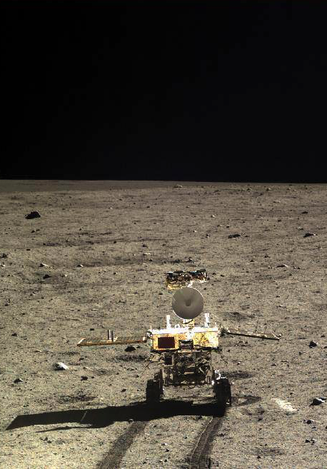
Mission and Product Requirements
Mission
to collect and bring back lunar samples
Rocket Rover
Total mass of rover shall
not exceed 500kg.
Solar panel shall not weigh more than 10kg.

Slide 10
What the ECSS says about requirements
ECSS-E-ST-10-06C “Technical requirements specification”
Provides “requirements on requirements” –i.e. how to:
  - Identify and capture requirements
  - Write requirements
    - including how to formulate “good” unambiguous requirements
    - definitions of “shall”, “should”, “may”, words to avoid...
  - Classify according to type of requirement
    - Functional, operational, physical, design…
Used to write e.g. the Prime’s System Specifications
It does not provide practical instructions on how to do requirements management.
This is needed for a mission definition and requirements flow down but is only informative for product/service development requirements under a call for proposals

Slide 11
Example of flown down requirement structure
Anatomy of a Technical Requirement as part of a mission / complex system
Heading
SA-123
/Created/
/ T,R,A
brings the structure and adds searchability and readability
unique requirement number needed for tracking
context / version history (part of tracking tool)
verification methods (e.g. test, analysis, review of design, inspection as per ECSS-E-ST-10-02C)
This is overkill for a stand alone product / service development but when supplying to large projects it is typical of the format you will see

Slide 12
Types of requirements
Main types:
Functional requirements: What does it have to do?
Performance requirements: How well does it have to do it, e.g. accuracy, speed..?
Physical requirements: How big and heavy can it be?
Interface requirements: What does it have to connect to and how (h/w, s/w, MMI)?
Environmental requirements: Under what conditions does it have to work?
All these are needed to be able to design any product / service!
Supplementary/ specific requirements:
Mission requirements Product Assurance (PA) induced requirements
Design requirements Operational requirements
Verification requirements Human factor requirements
Cost requirements

Slide 13
Requirement Evolution vs. TRL
TRL 1-2 | TRL 3-4 | TRL 5-6 | TRL>6
First iteration of key driving requirement(s). | First iteration of all key requirement(s) and constraints. Some may still be TBD or TBC. | Complete set of all requirements defining and driving the product and their validation and qualification. | Complete consolidated and frozen set of requirements.
Overall goal (draft) Key Functional Key Performance | Mission requirement/goal (final) Functional Performance Physical Environmental Interface (driving only) | Mission requirement/goal Functional Performance Physical Environmental Interfaces (all) Operational Human factor requirements Product Assurance (PA) induced requirements Design requirements (i.e. design constraints) Verification requirements GSE Requirements (draft) | Mission requirement/goal Functional Performance Physical Environmental Interface Operational requirements Human factor requirements Product Assurance (PA) induced requirements Design requirements (i.e. design constraints) Verification requirements GSE requirements

Slide 14
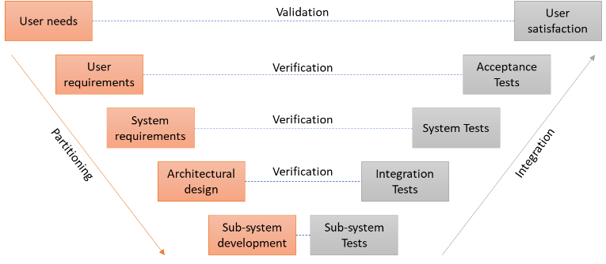
Requirement Formulation: Key aspects
Each Requirement Statement shall be:
  Clear and unambiguous – readily understandable and only one interpretation is possible.
  Correct and consistent – does not contain error of fact or contradiction to another requirement
  Realistic – can be satisfied within natural physical laws, state of the art technologies, and other project constraints
  Non-prescriptive – Shall state what is to be achieved, not how it is to be achieved.
  Verifiable – can be proven and demonstrated to have been achieved (e.g. through Inspection, Analysis or Test)
Organize requirements logically.
Requirements shall be traceable.
  i.e. it shall be clear why the requirement is there and from where it was derived

Slide 15
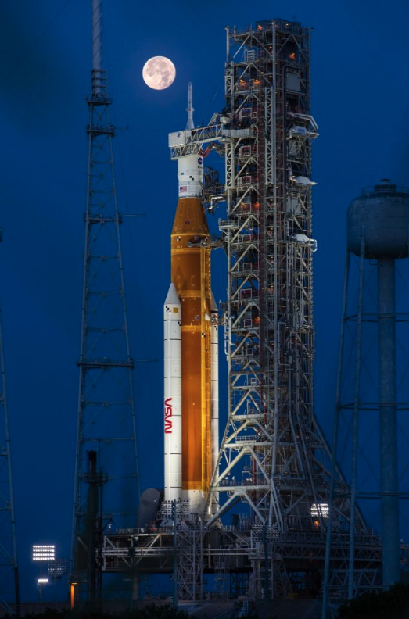
Requirement Formulation: Word Use
Specific formulation for requirements:
  Shall = a requirement that must be met
  Will = facts or declaration of purpose
  Should = a goal
  Could = an option
Example:
The rocket shall launch to the Moon.
The rocket will be used to bring humans to the Moon.
The rocket should be reusable.
The rocket could use liquid or solid propellants.

Slide 16
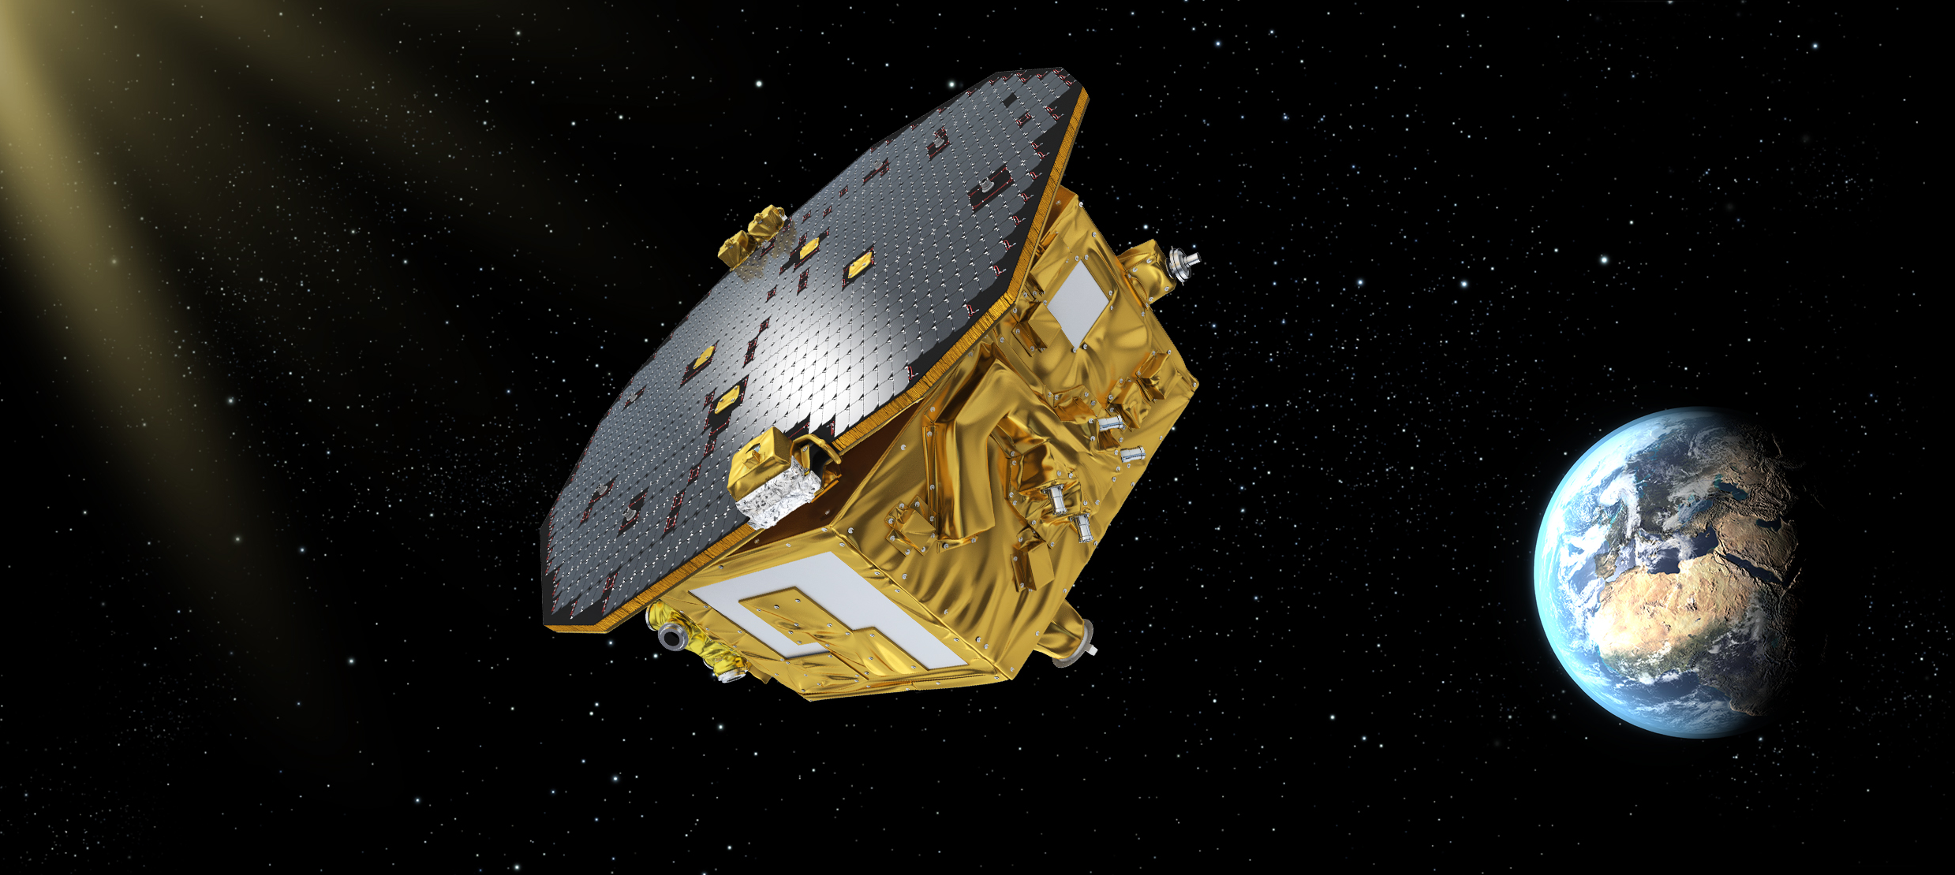
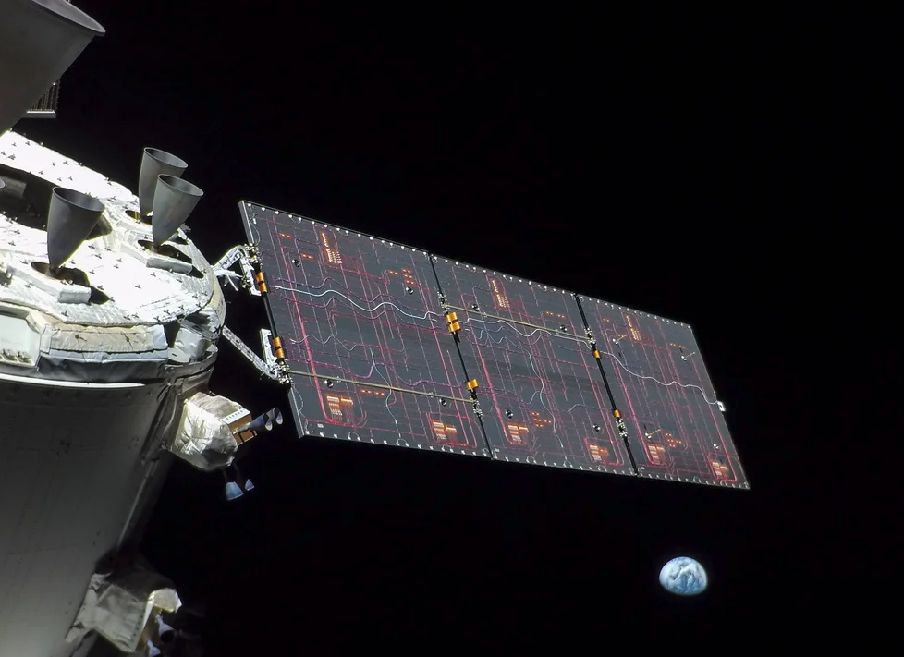
Example Product Requirements
The system shall operate at a power level of...
The software shall acquire data from the...
The structure shall withstand loads of...
The hardware shall have a mass not exceeding...

Slide 17

Example 1: Crop identification tool using EO data
The service shall monitor crop conditions and forecast yield using ESA Earth Observation (EO) data.
The service shall operate on both Windows and Mac machines.
The service shall use data from the Landsat and Sentinel-2A satellites.
The service shall display an area of 1km^{2.}
The service shall have a crop monitoring resolution of 5m.
The service shall forecast crop yield with a margin not exceeding 5%.
The service shall have a running cost not exceeding 25k€ 7 year.

Slide 18
Example 2: Solar Array (adapted from a real ESA mission)
Main functional requirements:
The Solar Array (SA) shall provide the following main functions:
Conversion of solar radiation into electrical power by means of solar cells
Provision of electrical power to the spacecraft during sunlit period
Provision of all necessary electrical wiring and protection between the cells and the electrical interface to the spacecraft
Mechanical support of the electrical elements
Thermal control of the assembly and sunshielding of the spacecraft
A solar flux monitor

Slide 19
Example 2: Solar Array (adapted from a real ESA mission)
The main functional requirement is broken further down into:
SA-01/Derived from SRS-1701/A,R
The Solar Array shall provide at least 650W at the Solar Array / spacecraft interface connector in the following
conditions:
35V at the Solar Array / spacecraft interface
Sun off pointing by up to 5 degrees to the panel
One string failed
Degradation and losses as defined in SA-00

Slide 20
Example 2: Solar Array (adapted from a real ESA mission)
Environmental requirements:
Lifetime / Ageing:
SA-48/Derived from SRS-2001/A,R
The Solar Array shall be designed for a minimum lifetime of:
60 months on ground (including testing and storage time)
24 months in orbit
During the possible total period, all spacecraft requirements shall be met.
SA-46/Derived from SRS-1701/A,R
The Solar Array supplier shall perform the design and analyses to establish the calculated temperature range that the Solar Array will experience throughout the mission using the environment shown in table ABCD.

Slide 21
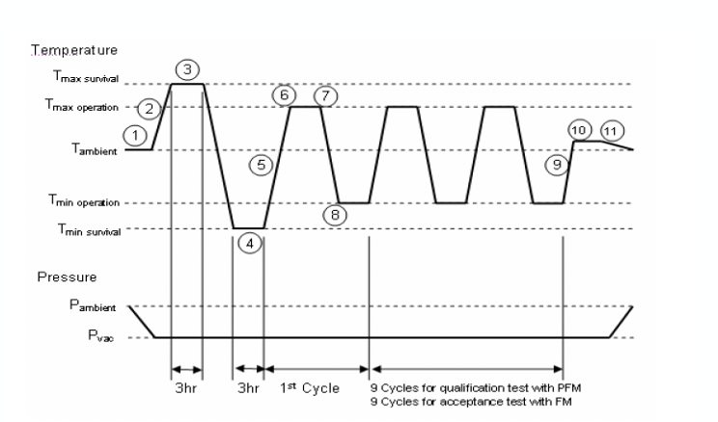
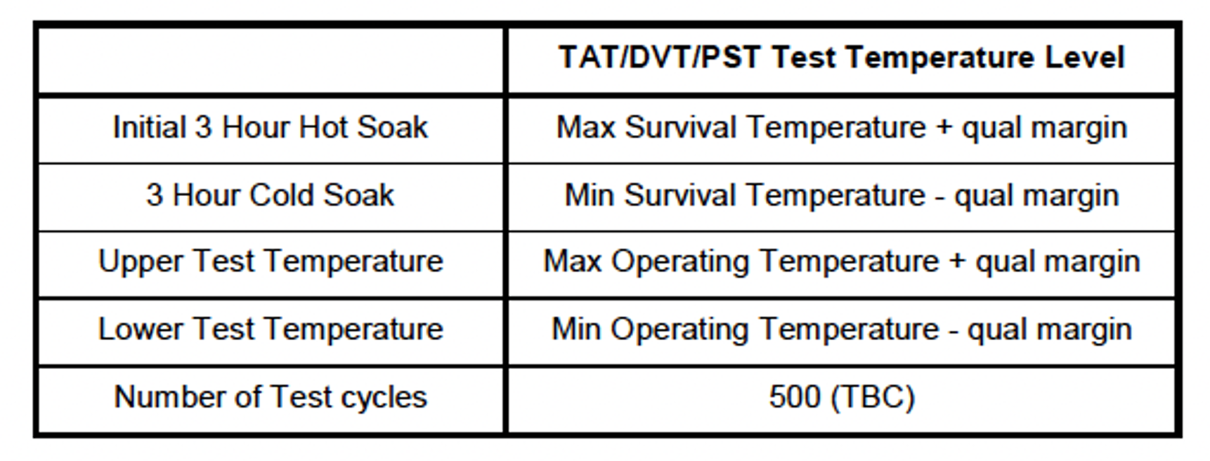
Example 2: Solar Array (adapted from a real ESA mission)
Verification requirements:
Thermal / vacuum test requirements:
The supplier shall demonstrate by test, compliance to the thermal and pressure environment requirements specified below:
SA-29/Created/T
For Test Sample Level Thermal Vacuum Tests, test levels for the TAT/DVT and PST shall be derived from the thermal environment defined in section 4.2 with the qualification margin included. The test sequence defined in table EFGH shall be followed.

Slide 22
Managing and controlling requirements

Slide 23
Requirements Margins Management
Definition “margin”:
The allowances carried in budget, projected schedules, and technical performance parameters (e.g., mass, power, memory, …) to account for uncertainties and risks during early design and analysis.
margins evolve during the development of the mission, and they decrease with the increase in knowledge of the system
margins shall not change the requirements, they change towards target design value, typical guidelines:
  Pre-SRR: 30% margin
  pre-PDR: 20% margin
  pre-CDR: 10% margin
  Acceptance Review (*): 5% margin

Slide 24
Requirements Margins Management
Mission limit
Customer
reserve
Requirement
Mass
Contractor
margin
predicted mass
actual mass
SRR
PDR
CDR
Flight

Slide 25
Verification of requirements
Definition Verification:
To establish confidence that the product / service will perform as expected.
4 fundamental methods for verifying a requirement:
  Inspection
  Analysis
  Review of Design
  Test
The Verification Control Document (VCD) helps to systematically monitor and check the level of compliance with the requirements and follows the verification of those requirements through the design and test life cycle and is therefore a key tool for project management and risk control.

Slide 26
Verification Control Document
Example of a simplified Verification Control Document (VCD) and its evolution throughout the development process
Req. # | Requirement | Expected value | Compliance | Compliance notes | Analysis/ Inspection Reference | Test Plan Reference | Test Report Reference
Phy1 | The mass shall be less than 2.0Kg | 1.95Kg | C | Expected value includes 30% maturity margin | Design Report Issue 1.0, Table 2.4 - Mass budget
Phy1 | The mass shall be less than 2.0Kg | 1.99Kg | C | Expected value includes 20% maturity margin | Design Report Issue 2.0, Table 2.4 - Mass budget | Physical Test Plan Issue 1.0, Section 3.0
Phy1 | The mass shall be less than 2.0Kg | 2.01Kg | PC | Measured Value, request for deviation submitted, see NCR 001 | Design Report Issue 2.0, Table 2.4 - Mass budget | Physical Test Plan Issue 1.0, Section 3.0 | Physical Test Report Issue 1.0, Section 3.1
Each of the above lines corresponds to a project review, i.e. the VCD shall be presented and updated at each review for each requirement!

Slide 27
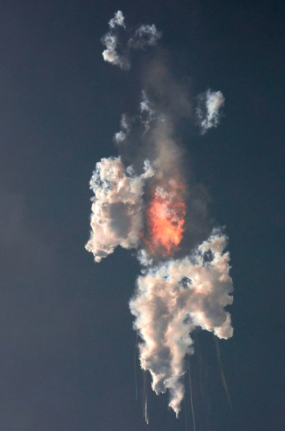
Impact of poor requirements
Poor requirements will lead to:
non-functional, incompatible, non-competitive products or services
creep in budget, timeline and resources
re-design, re-work
loss of (business) opportunities

Slide 28
Poor requirements - examples
“The system must have good usability”, “easy to use”, “robust”
  → difficult / impossible to validate
“Response time should be less than X seconds”
→ ambiguous, as it is open to different interpretation by different
people leading to different results
“The system has to be bug-free.”
→ difficult / impossible to meet / guarantee
“We need to procure XY materials.”
→ this is a pre-requisite, not a technical requirement
“We will do a market research.”
→ this is programme of work / implementation, not a technical
requirement.

Slide 29
Some “golden rules”…
Remember what requirements are for!
Use the correct terminology (shall).
Ensure requirements are complete (covering all areas), justified and verifiable.
Refrain from designing the system or describe the planned flow of work.
The use of “To Be Confirmed / Determined” (TBC / TBD) values should be minimized. TBC values shall be progressively reduced through the lifecycle of the development activity.
Requirement compliance should be progressively monitored, validated and verified through the design life cycle.

Slide 30


www.esa.int

